Slide 1
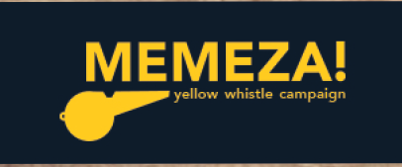
Session 4: Towards Positive Masculinities

Slide 2
Activity 2: ‘Agree | Disagree?’
Myth or Fact : 30 minutes
Task: Participants should stand in a single line as the facilitator reads out a statement/belief . Participants will then take two steps to the left if they agree, two steps two the right if they disagree or standstill if they are in between/unsure.
Depending on the time and what works best for the group, participants can either discuss after each point or after all the statements have been read

Slide 3
Introduction
In terms of gender attitudes, it has been found that dominate beliefs about the performance of manhood and what it means to be man are the some of the driving forces behind the violence described above. (Safety and Violence Initiative, 2019).
In short society has entrenched the idea that sexual violence, and the violence committed by men, is a normal and inevitable part of life. From childhood, boys are often taught and expected to act in ways characterized by high levels of aggression, withdrawal, sexual activity denial-avoidance and low concern for the needs of others. (Hooks, 2004)

Slide 4
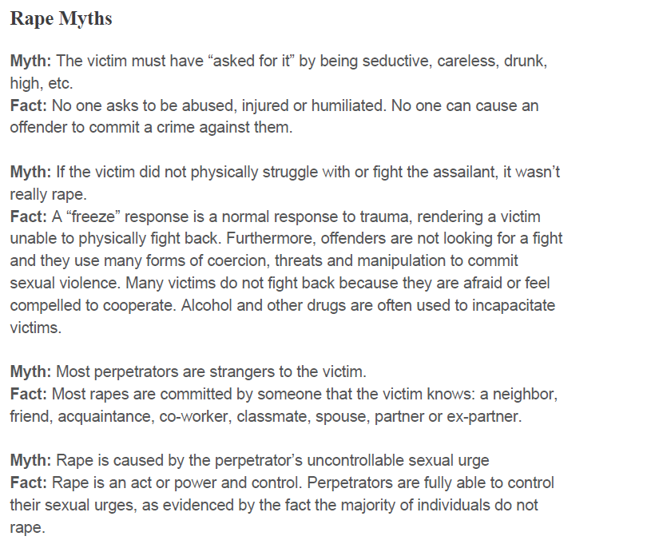

Slide 5
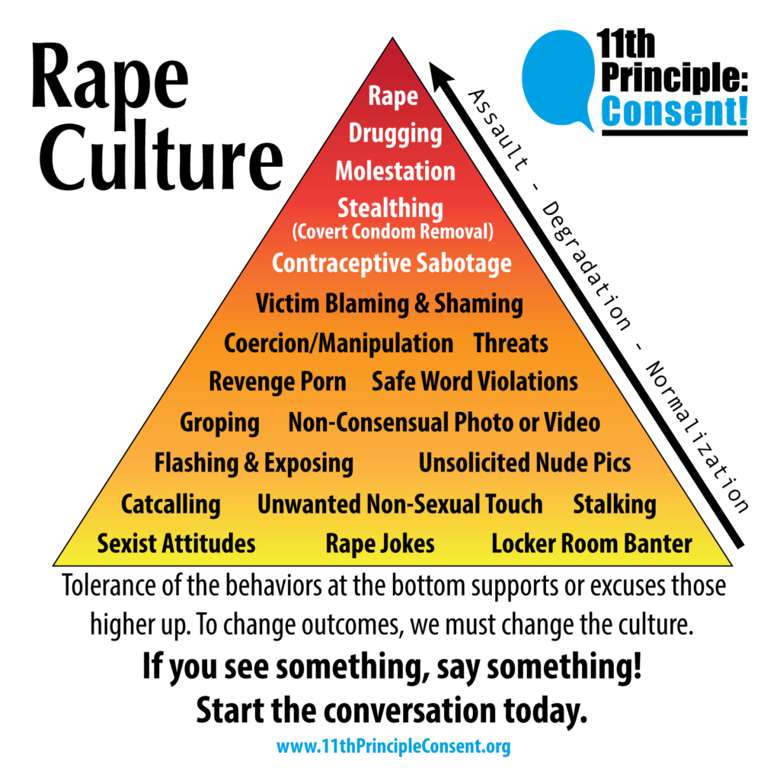

Slide 6
Session 3: Masculinity & Violence

Slide 7
Activity 1: My Breaking Point
20 Minute
Group Discussion: Participants must reflect on their past and think about a moment in their life when they became violent.
Participants will then share about a point in their life where they lost themselves and became violent.
What caused it?
What role if any, did the need to prove your manhood play a factor?
Was there another alternative to violence at the time?

Slide 8
What is Rape Culture?’
You have the power to choose to leave behind language and lyrics that blame victims, objectify women and excuse sexual harassment. What a woman is wearing, what and how much she had to drink, and where she was at a certain time, is not an invitation to rape her.

Slide 9
" The Violence I should Underscore comes in different forms. It is direct and Indirect. It is against Children, against women, against other men and against the self "
Kopano Ratele

Slide 10
Introduction
Framing the session
In the last session we explored - beliefs, how they can be limiting and how to think about them critically.
We also briefly touched on the link between gender norms, and their link to violence.
In this session, we examine this link in more depth, as we look at the connection between masculine norms and violence to ourselves and to others.

Slide 11
Introduction
According to the world health organization, violence entails the intentional use of physical force or power, threatened or actual, that either results in or has a high likelihood of resulting in injury, death, psychological harm, maldevelopment or deprivation. (World Health Organization, 2002)
Violence can be self-directed, directed against others or structural in nature. High levels of violence and crime in regions such as South Africa are often the symptoms of underlying social, economic, and political challenges such as social inequality, rapid urbanisation, poverty, unemployment, and institutional limitations. (Safety and Violence Initiative, 2019)

Slide 12
Introduction
In this regard, South Africa’s history of colonialism, and apartheid means that violence is something we must contend with daily. From the spatial inequality, degradation, and material deprivation that characterize township life, to domestic abuse, gang violence or sexual assault; South Africa has a lot of work to do to lessen the occurrence of violence and its impact. To do this well, it is important to understand the intersectional causes violence in society and its gendered nature.

Slide 13
Introduction
Over the years, sociologist have found that violence – murder, rape, intimate partner violence or gang related committed against women, children, or men, is predominately committed by men (Barker, 2018). Globally, men are also more likely to suffer from addiction, suicide, or be the victim of homicide. (Clowes, 2013) (Jewkes)
While it is tempting to explain the above findings, through biology and its assumption that men are naturally more violent; this is too simplistic.
Violence involves complex web of intersecting elements, including social conditions, life circumstances, childhood experiences, political economy, gender attitudes, and more. (Barker, 2018)

Slide 14
Aims & Objectives
Understand Gendered Roles and their connection to Violence
Explore how this plays out at a personal level
Unpack ‘ rape culture’, and challenge the beliefs which perpetuate it

Slide 15
Reflections and closing

Slide 16
Thank you!

Slide 17
Introduction
According to the world health organization, violence entails the intentional use of physical force or power, threatened or actual, that either results in or has a high likelihood of resulting in injury, death, psychological harm, maldevelopment or deprivation. (World Health Organization, 2002)
Violence can be self-directed, directed against others or structural in nature. High levels of violence and crime in regions such as South Africa are often the symptoms of underlying social, economic, and political challenges such as social inequality, rapid urbanisation, poverty, unemployment, and institutional limitations. (Safety and Violence Initiative, 2019)

Slide 18
Introduction
In this regard, South Africa’s history of colonialism, and apartheid means that violence is something we must contend with daily. From the spatial inequality, degradation, and material deprivation that characterize township life, to domestic abuse, gang violence or sexual assault; South Africa has a lot of work to do to lessen the occurrence of violence and its impact. To do this well, it is important to understand the intersectional causes violence in society and its gendered nature.

Slide 19
Introduction
Over the years, sociologist have found that violence – murder, rape, intimate partner violence or gang related committed against women, children, or men, is predominately committed by men (Barker, 2018). Globally, men are also more likely to suffer from addiction, suicide, or be the victim of homicide. (Clowes, 2013) (Jewkes)
While it is tempting to explain the above findings, through biology and its assumption that men are naturally more violent; this is too simplistic.
Violence involves complex web of intersecting elements, including social conditions, life circumstances, childhood experiences, political economy, gender attitudes, and more. (Barker, 2018)

Slide 20
Introduction
Framing the session
In the last session we explored - beliefs, how they can be limiting and how to think about them critically.
We also briefly touched on the link between gender norms, and their link to violence.
In this session, we examine this link in more depth, as we look at the connection between masculine norms and violence to ourselves and to others.

Slide 21
Activity 2: ‘Agree | Disagree?’
Myth or Fact : 30 minutes
Task: Participants should stand in a single line as the facilitator reads out a statement/belief . Participants will then take two steps to the left if they agree, two steps two the right if they disagree or standstill if they are in between/unsure.
Depending on the time and what works best for the group, participants can either discuss after each point or after all the statements have been read

Slide 22
Introduction
In terms of gender attitudes, it has been found that dominate beliefs about the performance of manhood and what it means to be man are the some of the driving forces behind the violence described above. (Safety and Violence Initiative, 2019).
In short society has entrenched the idea that sexual violence, and the violence committed by men, is a normal and inevitable part of life. From childhood, boys are often taught and expected to act in ways characterized by high levels of aggression, withdrawal, sexual activity denial-avoidance and low concern for the needs of others. (Hooks, 2004)

Slide 23
What is Rape Culture?’
What is Rape Culture?
Rape culture is the social environment that allows sexual violence to be normalized and justified, fueled by the persistent gender inequalities and attitudes about gender and sexuality.
It persists through language, attitudes and beliefs which objectify women’ and blames them for being victims of abuse.
Rape-affirming beliefs are embedded in our language: “She was dressed like a slut. She was asking for it,”
It is part of popular song lyrics: “I know you want it.”
It is normalized by objectifying women and calling them names in pop culture and media.

Slide 24
Session 3: Overview
Roadmap for Today!
Welcome (5min)
Framing The Session(5min)
Aims & Objectives(5min)
Activity 1: Breaking Point (30min)
Activity 2: ‘What is rape culture?’ (30min)
Reflections

Slide 26
Aims & Objectives
Understand Gendered Roles and their connection to Violence
Explore how this plays out at a personal level
Unpack ‘ rape culture’, and challenge the beliefs which perpetuate it

Slide 27
Activity 1: My Breaking Point
20 Minute
Group Discussion: Participants must reflect on their past and think about a moment in their life when they became violent.
Participants will then share about a point in their life where they lost themselves and became violent.
What caused it?
What role if any, did the need to prove your manhood play a factor?
Was there another alternative to violence at the time?

Slide 28
Activity 2: ‘Agree | Disagree?’
Statements
Buying a woman, a lot of expensive drinks at the club means that they should go home with you.
Someone accepting an invite to your house, late at night when you are alone means that they want to have sex with you.
Anger Causes violence
A real man can control his women.
Jealousy is a sign of love
Sometimes women put themselves in dangerous situations where they can be sexually assaulted.
Women make false allegations all the time.
Sometimes women play hard-to-get. So when they say no it mean’s keep trying
Women need to dress respectable to avoid being assaulted.
Men are naturally violent

Slide 30
What is Rape Culture?’
You have the power to choose to leave behind language and lyrics that blame victims, objectify women and excuse sexual harassment. What a woman is wearing, what and how much she had to drink, and where she was at a certain time, is not an invitation to rape her.

Slide 31
Session 3: Masculinity & Violence

Slide 32
Thank you!

Slide 33
Reflections and closing

Slide 34
Activity 2: ‘Agree | Disagree?’
Statements
Buying a woman, a lot of expensive drinks at the club means that they should go home with you.
Someone accepting an invite to your house, late at night when you are alone means that they want to have sex with you.
Anger Causes violence
A real man can control his women.
Jealousy is a sign of love
Sometimes women put themselves in dangerous situations where they can be sexually assaulted.
Women make false allegations all the time.
Sometimes women play hard-to-get. So when they say no it mean’s keep trying
Women need to dress respectable to avoid being assaulted.
Men are naturally violent

Slide 35
Session 3: Overview
Roadmap for Today!
Welcome (5min)
Framing The Session(5min)
Aims & Objectives(5min)
Activity 1: Breaking Point (30min)
Activity 2: ‘What is rape culture?’ (30min)
Reflections

Slide 36
What is Rape Culture?’
What is Rape Culture?
Rape culture is the social environment that allows sexual violence to be normalized and justified, fueled by the persistent gender inequalities and attitudes about gender and sexuality.
It persists through language, attitudes and beliefs which objectify women’ and blames them for being victims of abuse.
Rape-affirming beliefs are embedded in our language: “She was dressed like a slut. She was asking for it,”
It is part of popular song lyrics: “I know you want it.”
It is normalized by objectifying women and calling them names in pop culture and media.

Slide 37
" The Violence I should Underscore comes in different forms. It is direct and Indirect. It is against Children, against women, against other men and against the self "
Kopano Ratele

Slide 38
Session 4: Overview
Roadmap for Today! (1hr30min)
Welcome (5min)
Framing The Session(5min)
Aims & Objectives(5min)
Activity 1: In Her Shoes
Activity 2: New Norm! New Rules
Activity 3: The Pledge What can we do (10 min)
Reflections

Slide 39
Introduction
Framing the session
In the last session we looked at the relationship between our performance of manhood and violence.
while this was important to do, we must remember that violence is not inherent to manhood – men are not naturally violent and not only men commit violence. (Barker, 2018)
All over the world, and right here at home, men are kind, thoughtful and helpful. Many continue to resist and have worked hard against a culture that tells them they that to be a man, one must be violent, unfeeling, and dominating,

Slide 40
Introduction
Framing the session
With that said, the rate at which violence against women, children and the LGBTQI community continue to occur means that there is not enough of these men and there are not enough alternatives to toxic, masculinity. This is something we must change. We need to create a new normal!

Slide 41
Introduction
In terms of what this new normal will look like, that is not something can or want to define for you. It must be something we work together to shape and fulfil.
We know that for positive masculinity to be a true alternative, it must be based on interdependence, communication, empathy and the respect and recognition of the full humanity of women, children, and each other.

Slide 42
Aims & Objectives
To foster empathy and a transformative approach to gender relations.
To Examine healthy alternatives in (re)defining positive masculinity
To Commit to positive masculinity through advancing the principles of human dignity, equality, and fairness.

Slide 43
Activity 1: In Her Shoes
To live freely, is to live a life without fear, coercion, violence, or Discrimination.
• Participants must split into breakaway groups of 3.
• In each group, participants must think about, about some of the constraints placed on women by the society we live in.
- Think in terms of safety i.e things/characteristics/habits that woman need to survive i.e., not get harassed, raped, assaulted, kidnapped.
- Or in terms of relationships, bodily autonomy
• Participants have 10minutes to complete their list, then return to main session for group discussion for about 15 min, each group shares their list and reason?
30 Minute

Slide 44
Activity 2: In Her Shoes
Discussion Points:
What does living freely mean to you?
In terms of the definition above and your own, do women live freely in SA?
How would you feel if some of the constraints were placed on you?
Have you ever told/taught a women/girl any of the things listed?
In what ways may you have contributed to some of the abovementioned constraints]
Part 2

Slide 45
Activity 2: New Norm! New Rules
It’s a new world and your crew have just formed a team called New Men FC. In your groups, develop a list of guidelines that new members would have to abide by. The aim is to be positive roles models in your community for a freer, safer and more equal world.
Participants must split into two groups.
30 min

Slide 46
The Pledge:
See document Attached

Slide 47
Thank you!

